Slide 1
I/O!
Micro:Bit Lesson 2

Slide 2
I/O in Micro:Bit
I/O stands for input and output. This is how you will interface with your Micro:Bit. One way you can input information to the Micro:Bit is through Pins. (Go through with the team and change to something more descriptive) (Maybe add a slide about the GND pin)

Slide 3
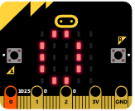
Pin 0
I/O stands for input and output. This is how you will interface with your Micro:Bit. One way you can input information to the Micro:Bit is through Pins.
Ex:
Let foo0 = 0
input.onPinPressed(TouchPin.P0, function () {
basic.showNumber(foo0)
})

Slide 4
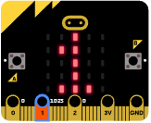
Pin 1
Ex:
Let foo1 = 1
input.onPinPressed(TouchPin.P1, function () {
basic.showNumber(foo1)
})

Slide 5
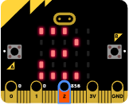
Pin 2
Ex:
Let foo2 = 2
input.onPinPressed(TouchPin.P2, function () {
basic.showNumber(foo2)
})

